Slide 1
Pgbench custom scripts
Susan Wu

Slide 2

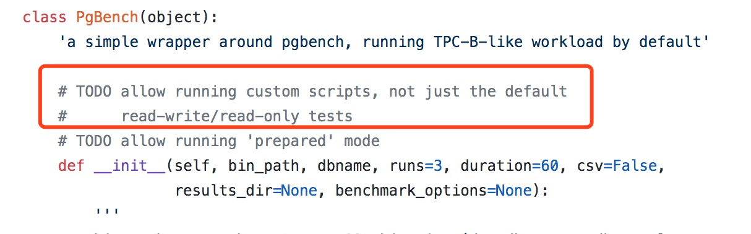
Why do this？

Slide 3
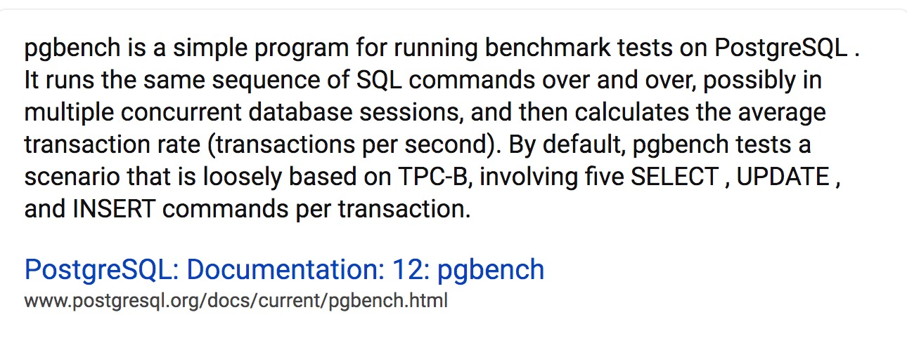
What is pgbench ？

Slide 4

What is pgbench ？
Database stress testing tool
comes with PostgreSQL

Slide 5
Since pgbench provide this tools ,
what can we do in this project?

Slide 6
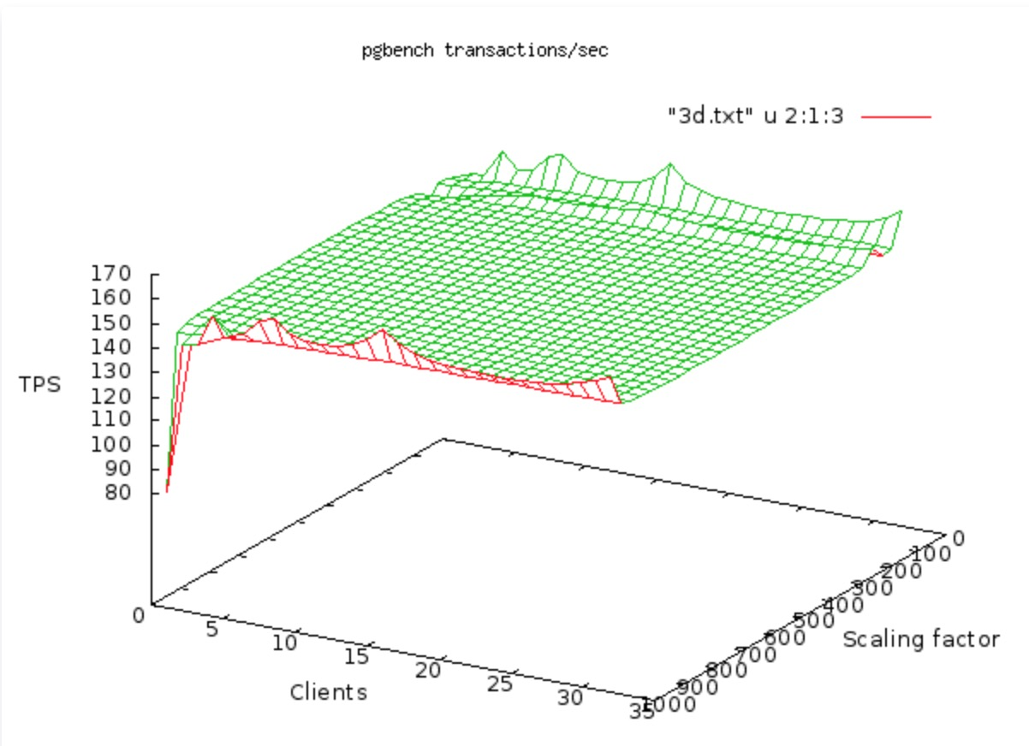

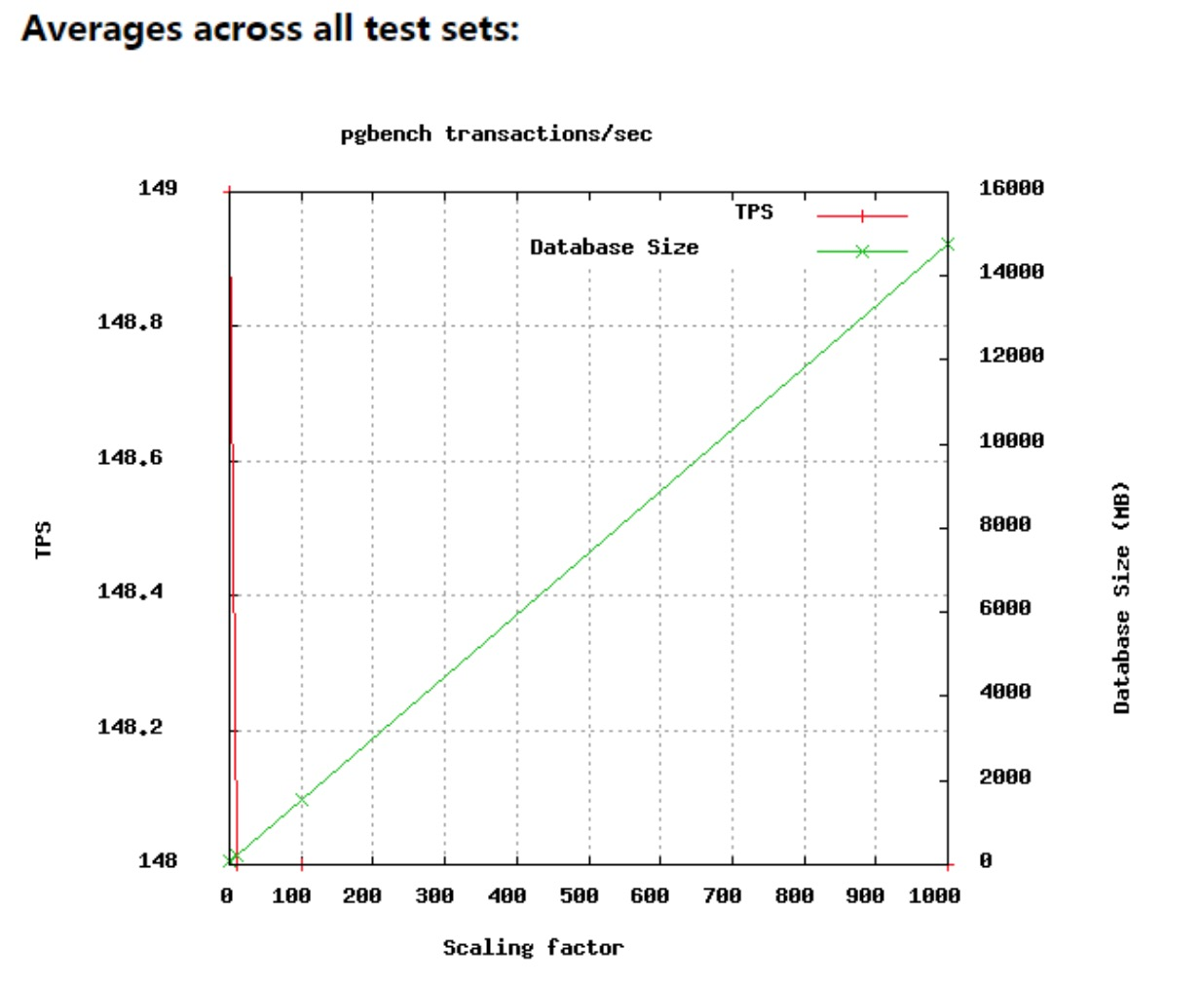
To collect result and analysis it

Slide 7
pgbench simple use case
If you installed postgre,
you installed pgbench
Check the installation

Slide 8
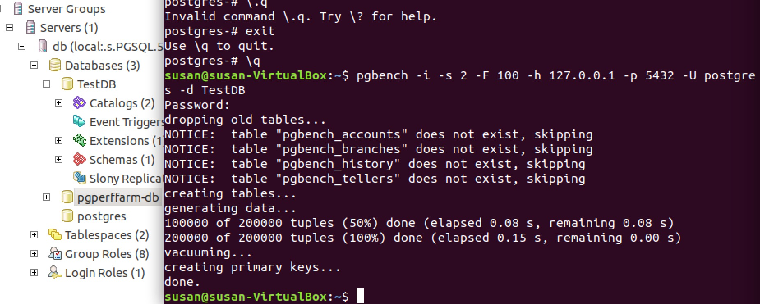
pgbench simple use case
Step 1: Initialization
pgbench -i

Slide 9
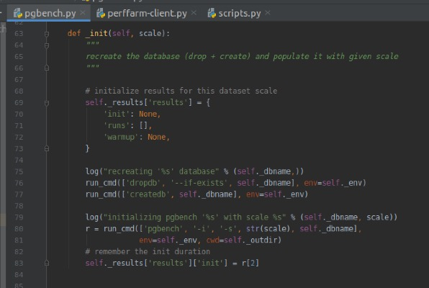

Slide 10
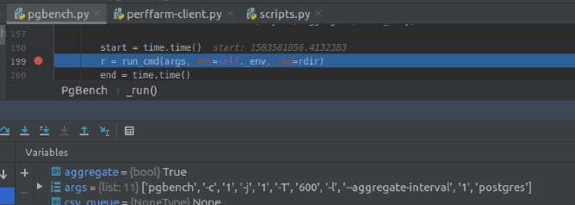
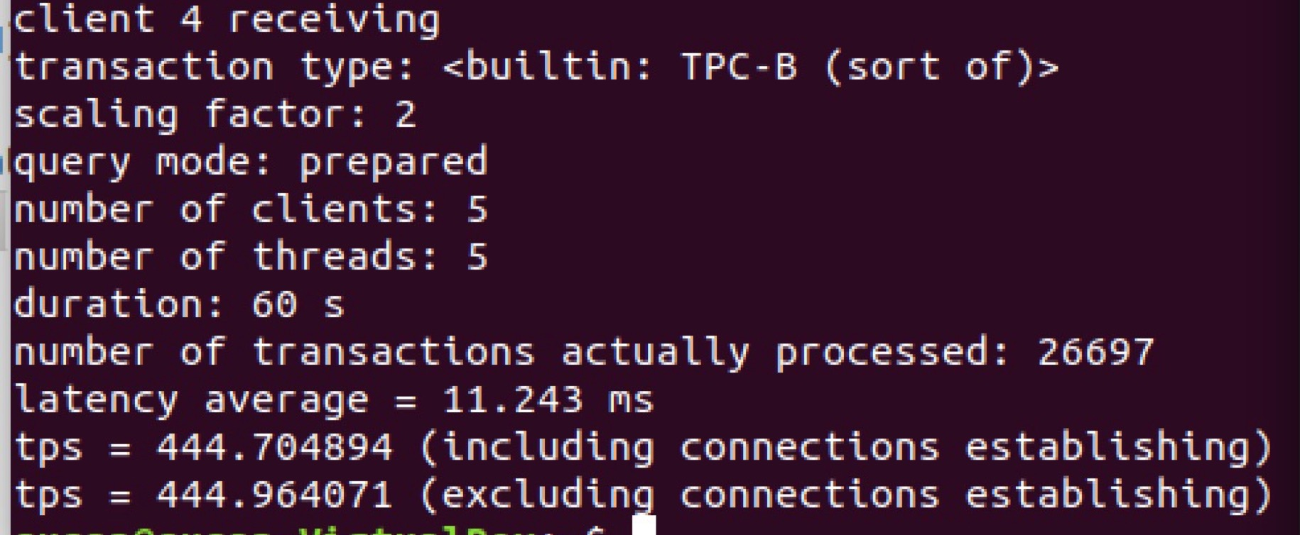
Step 2: run test command

Slide 11
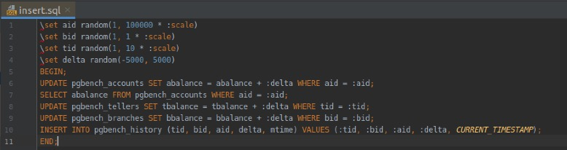
pgbench custom scripts case
“pgbench -f insert.sql -U postgres TestDB”for insert.sql
“pgbench -f A.sql -f B.sql -U postgres TestDB” for A.sql&B.sql

Slide 12
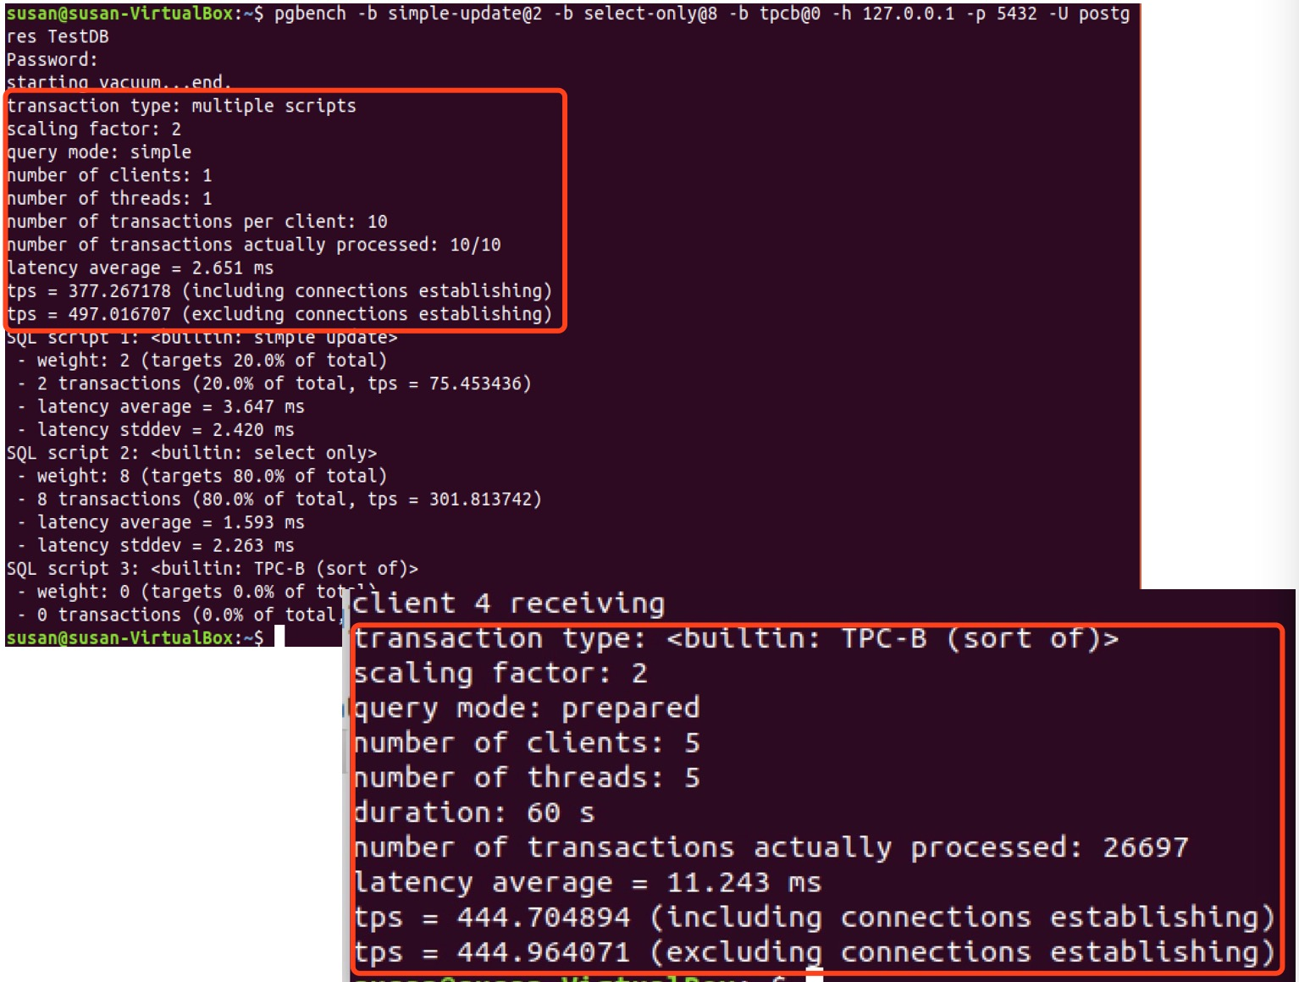

Slide 13
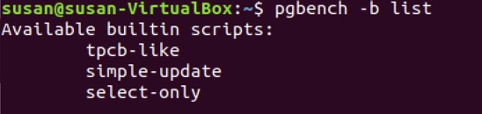
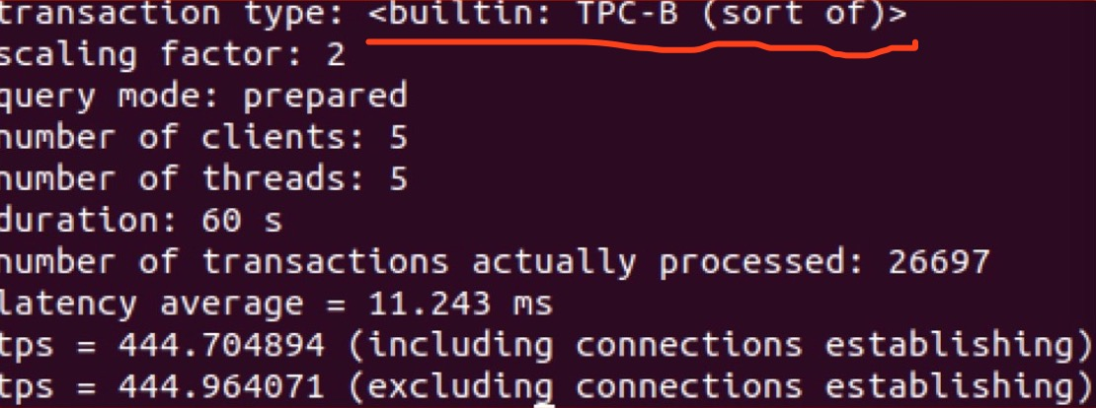
More about pgbench script
Bgbench has its own script
That means
If you did not declare which script to run,
pgbench will use one of builtin scripts

Slide 14
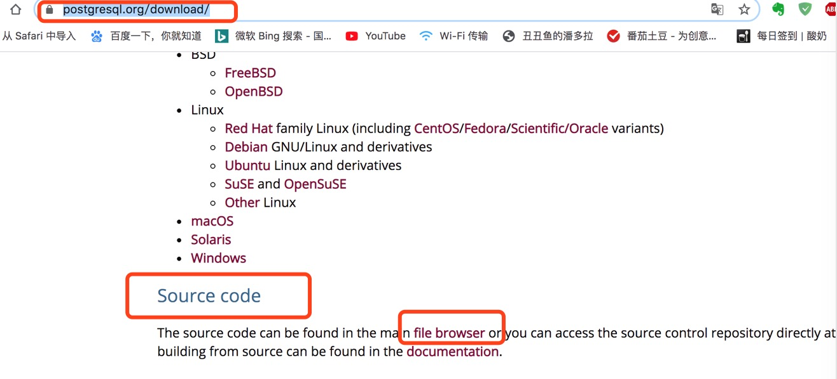
More about pgbench script
What is buildin script look like

Slide 15
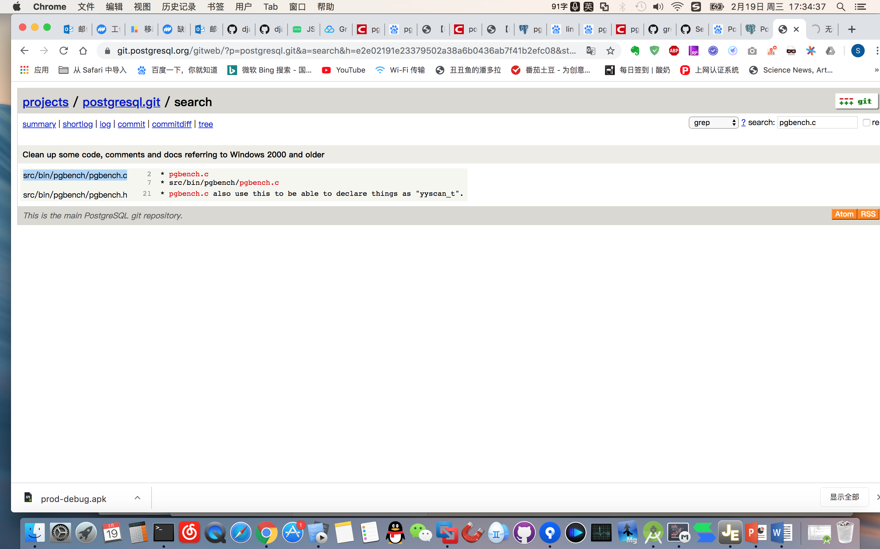

Slide 16
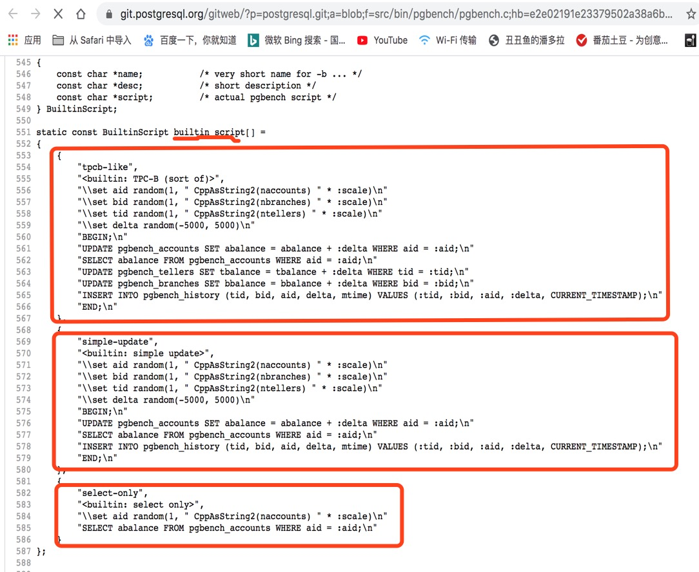

Slide 17
Project implementation

Slide 18
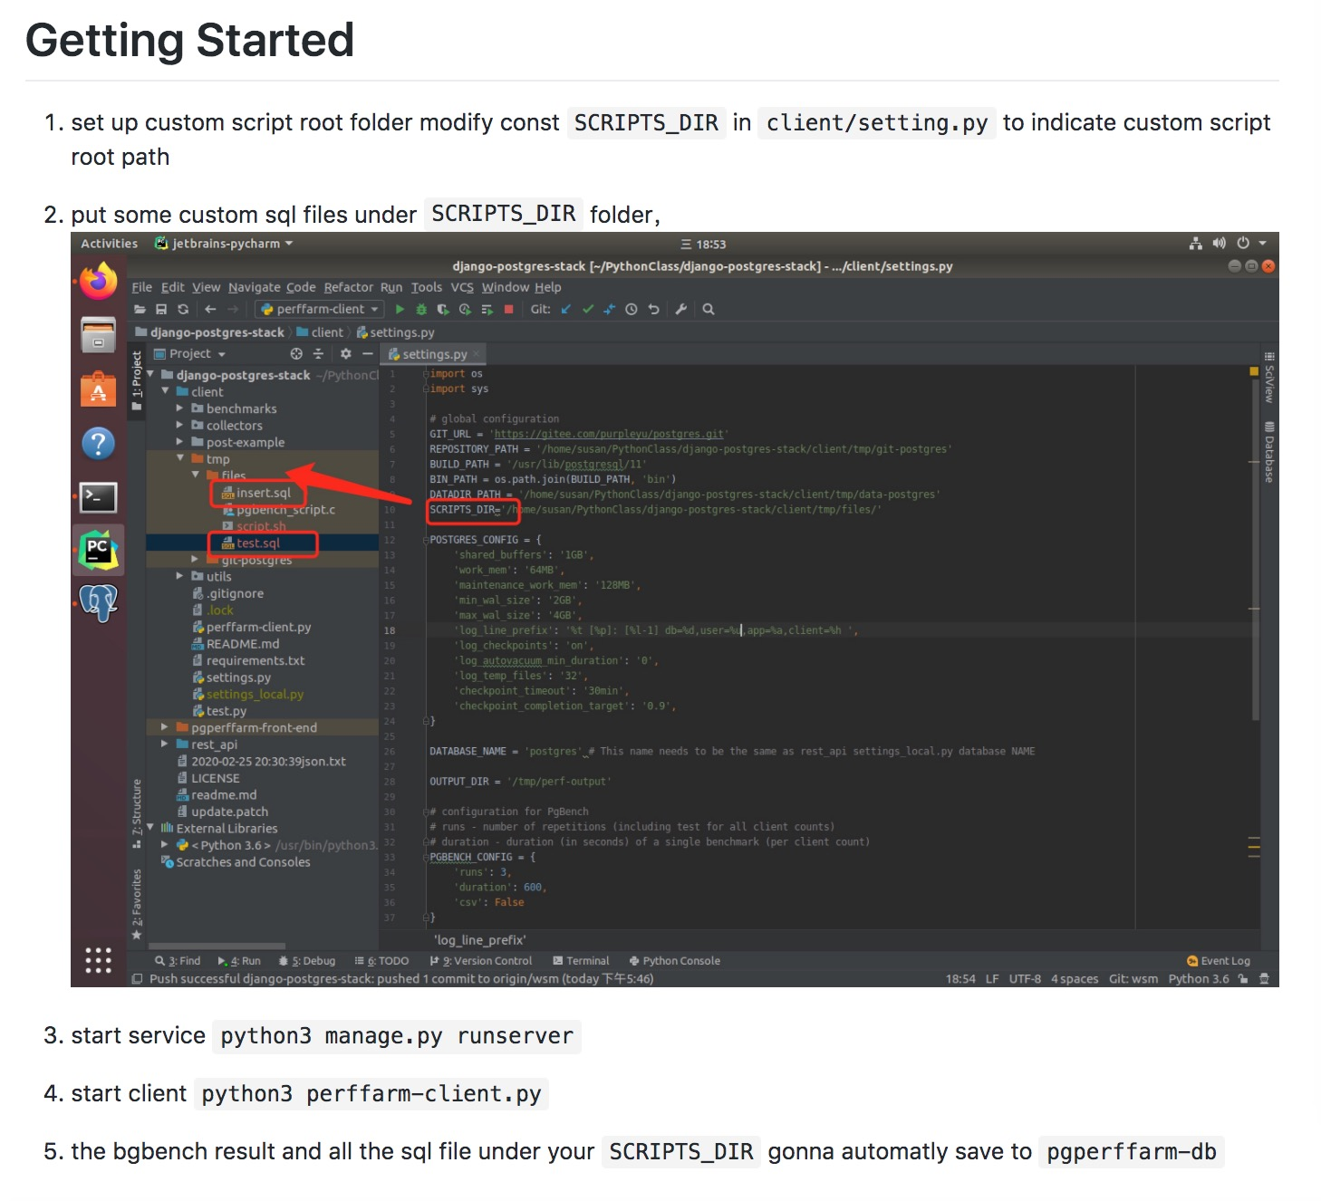

Slide 19
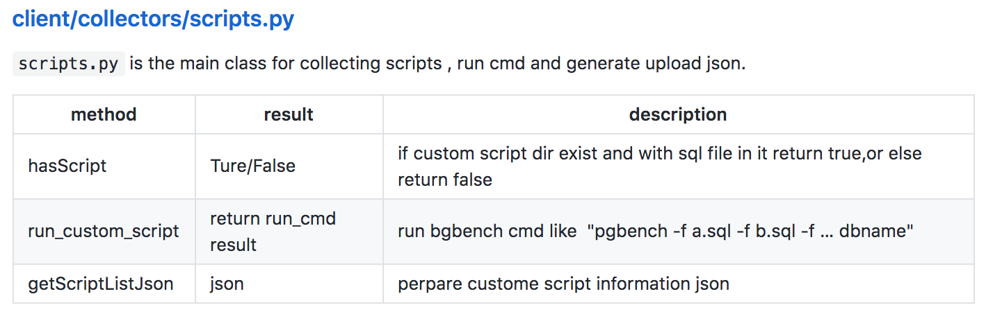
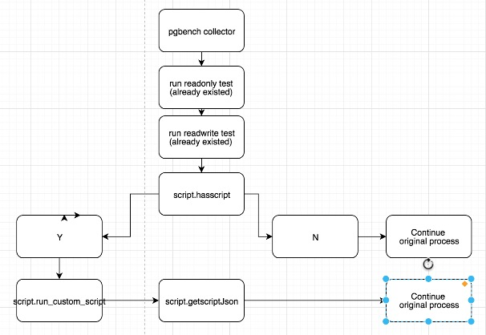
Process flow

Slide 20
